Slide 1
Web-Based Computer-Aided Instruction for Preschool Students

Slide 2
Chapter 1
the problem and its background

Slide 3
Introduction
Chapter 1
Preschool is a necessary step for preparing toddlers for higher education.
Due to pandemic, there is an abrupt shift from physical to digital learning.
To develop a system using CAI with Adaptive Learning to provide aid to Preschool education.

Slide 4
Statement of the Problem
Chapter 1
1. What are the limitations and problems posed by traditional teaching to the pre-school teachers with regards to:
assessing of children's knowledge;
keeping children engaged with the lessons; and
children's cognitive ability?

Slide 5
Statement of the Problem
Chapter 1
2. What are the features that the proposed system will contain that would help improve and resolve these problems and limitations?
3. What is the web development expert's assessment on the proposed system in terms of;
functionality;
usability;
efficiency; and
maintainability?

Slide 6
Statement of the Problem
Chapter 1
4. What are the parents and teacher's assessment on the proposed system in terms of;
functionality;
usability;
efficiency; and
portability?

Slide 7
Conceptual framework of the study
Chapter 1
Knowledge Requirements
Preschool and Kinder Curriculum
Web-based Programming Skills
Database Management Skills
Human-Computer Interaction skills
Software Requirements
Visual Studio Code
Xampp
Adobe Software
Hardware Requirements
Personal Computer
2.6 GHz Processor
4GB RAM
Scrum Agile Methodology
Scrum Events
The Sprint
Sprint Planning
Daily Scrum
Sprint Review
Sprint Retro perspective
Scrum Artifacts
Product Backlog
Sprint Backlog
Increment
Web-based Computer-Aided Instruction for Preschool
Students

Slide 8
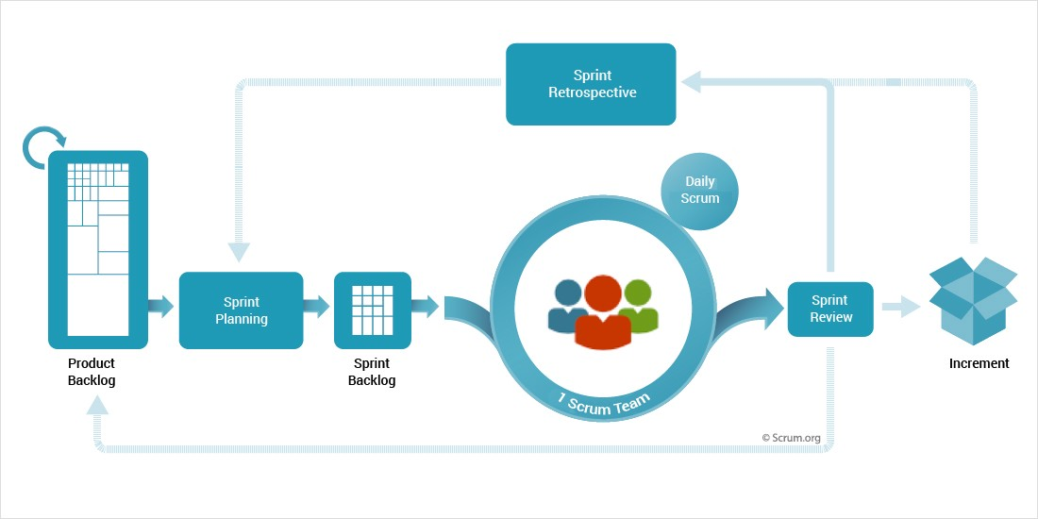
Scrum Agile Methodology
Chapter 1

Slide 9
Chapter 1
Significance of the study
The study to be conducted by the researchers pose great significance to the transitions needed on improving the ways in which education is presented to the students. With the premise of introducing a platform in which a student can learn from an intuitive system designed for preschool to kinder learning.

Slide 10

Chapter 1
Significance of the study
School
Teachers
Students
Parents

Slide 11
Chapter 1
Significance of the study
IT Students
Researchers
Future Researchers
Education System

Slide 12
Scopes and Limitations
Chapter 1
Limitation
The learning materials used are limited and may not be included in other books.
Scopes
Providing assessments to preschool students
Parents will be able to monitor the students activity and attendance
The proposed system provides adaptive learning activities to students
Validating of attendance for the teachers

Slide 13
Chapter 2
Review of Related Literature and Studies

Slide 14
Review of Related Literature and Studies
Chapter 2
Education System and Issues
Children Learning Development and Psychology
Transition of Learning in the Philippines
Computer-Aided Instruction and Adaptive Learning

Slide 15
Chapter 3
Methods and Procedures

Slide 16
Research Design
Chapter 3
Quantitative and Qualitative data will be collected on the research in short, the researchers will be integrate a mixed method of data collection.
The researchers will be using a descriptive type of research to gather information.
The descriptive type of research is an appropriate choice for the topic since this investigates one or more variables.

Slide 17
Chapter 3
Respondents of the study
To gather the necessary data, the researchers will use a non-probability sampling technique. Purposive sampling is a sampling method which enables the researchers to choose their own sample from a population.

Slide 18
Chapter 3
Respondents of the study
Parents/Guardian
Teachers
Web-development Expert

Slide 19
Chapter 3
Data gathering tools
Interview
Internet
Library
Survey

Slide 20
Chapter 3
Data Analysis Plan
The scale to be used for the survey is the Likert scale. The Likert scale assumes that the intensity of an attitude is linear and uses five to seven linear responses to assume the measure of an attitude.
Option | Code
Strongly Agree (SA) | 5
Agree (A) | 4
Undecided (U) | 3
Disagree (D) | 2
Strongly Disagree (SD) | 1

Slide 21
System Development
Chapter 3
The methodology to be used in developing the proposed system is the Scrum agile methodology. The Scrum agile methodology is a widely used framework in the development of system software that is both lightweight and easy to understand. It is composed of several phases which are Initiate, Plan and Estimate, Implement, Review and Retrospect, and Release.

Slide 22
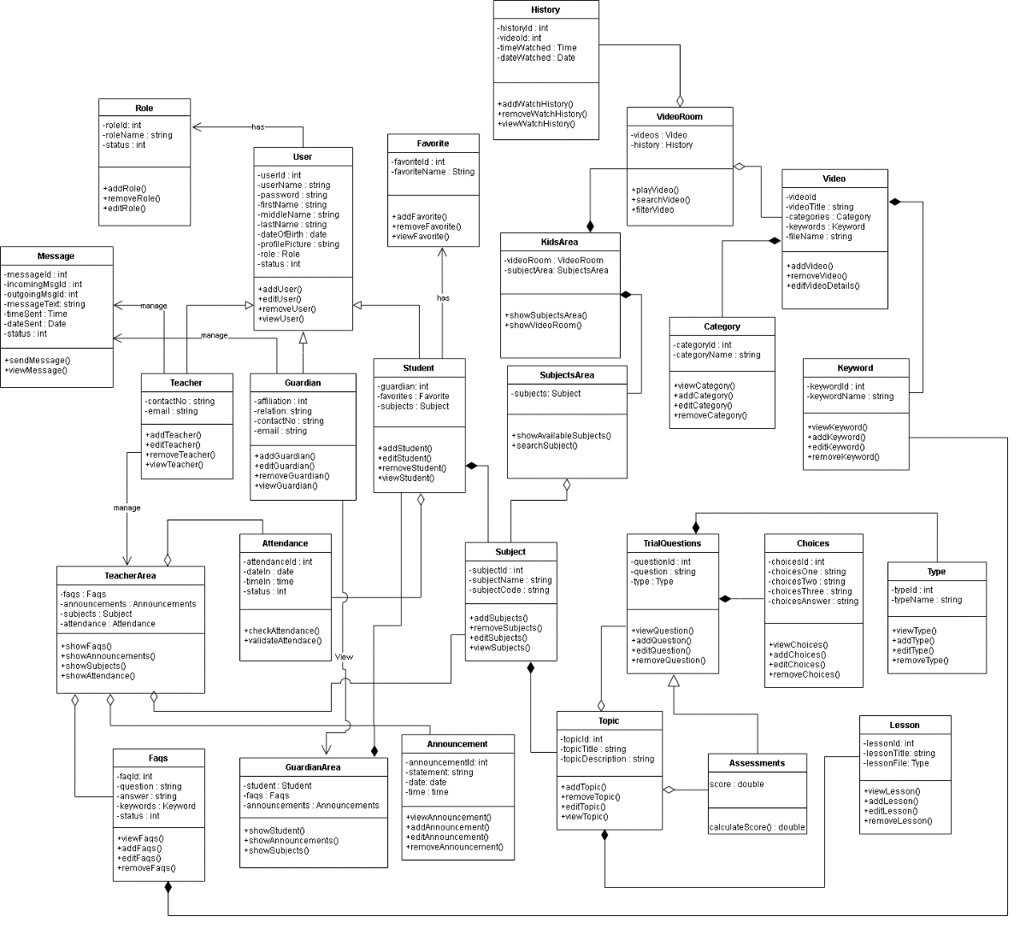
Class Diagram
Chapter 3

Slide 23
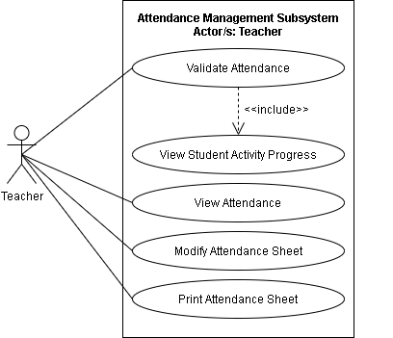
Use Case Diagram for Attendance Management Subsystem
Chapter 3

Slide 24
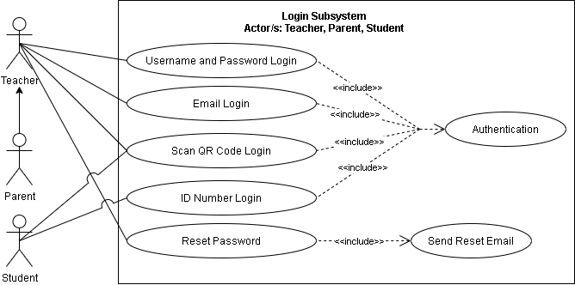
Use Case Diagram for Login Subsystem
Chapter 3

Slide 25
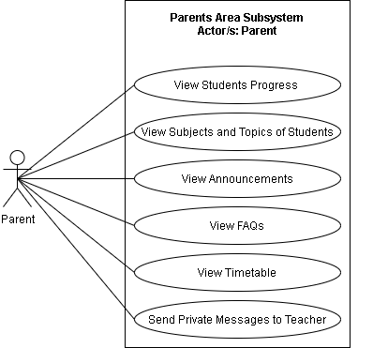
Use Case Diagram for Parents Area Subsystem
Chapter 3

Slide 26
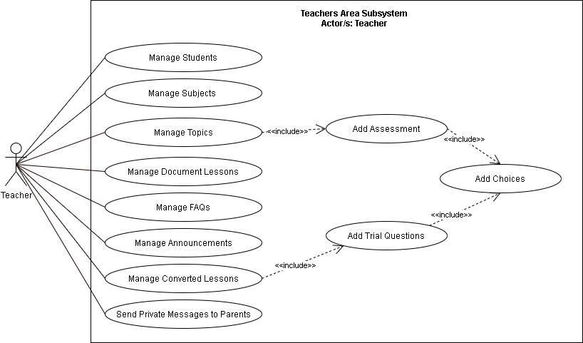
Use Case Diagram for Teachers Area Subsystem
Chapter 3

Slide 27
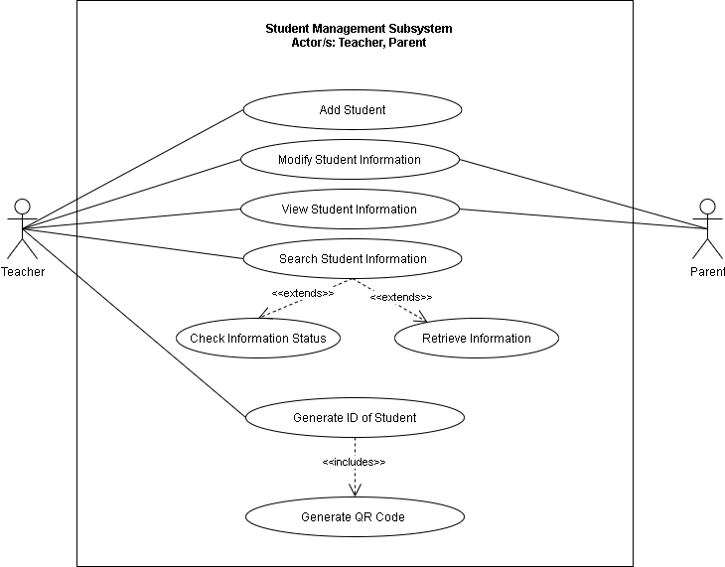
Use Case Diagram for Student Management Subsystem
Chapter 3

Slide 28
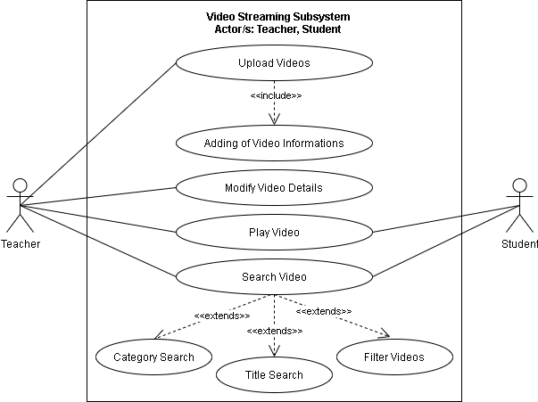
Use Case Diagram for Video Streaming Subsystem
Chapter 3

Slide 29
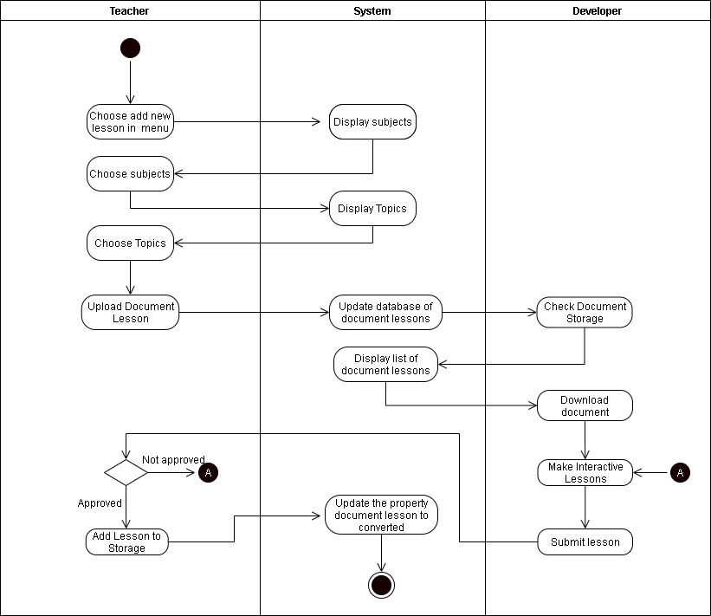
Activity Diagram for Add Interactive Lessons
Chapter 3

Slide 30
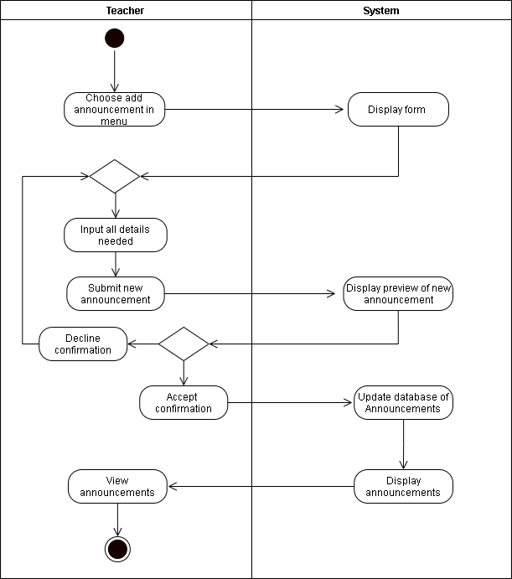
Activity Diagram for Adding Announcement
Chapter 3

Slide 31
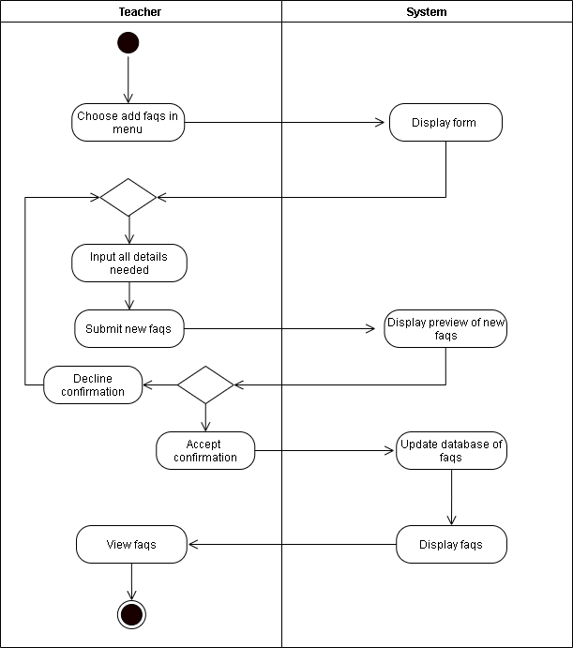
Activity Diagram for Adding FAQs
Chapter 3

Slide 32
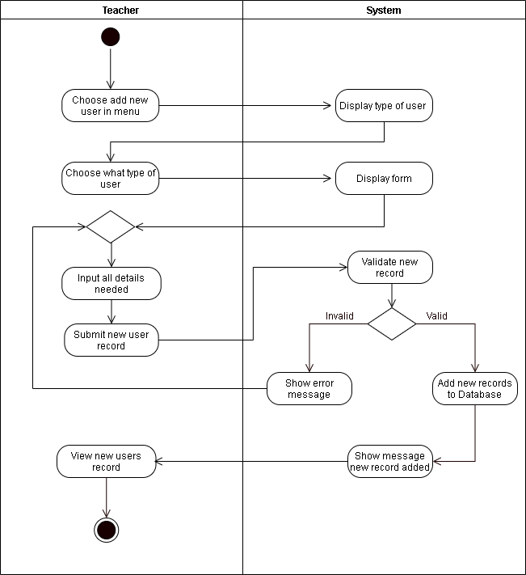
Activity Diagram for Adding of Users
Chapter 3

Slide 33
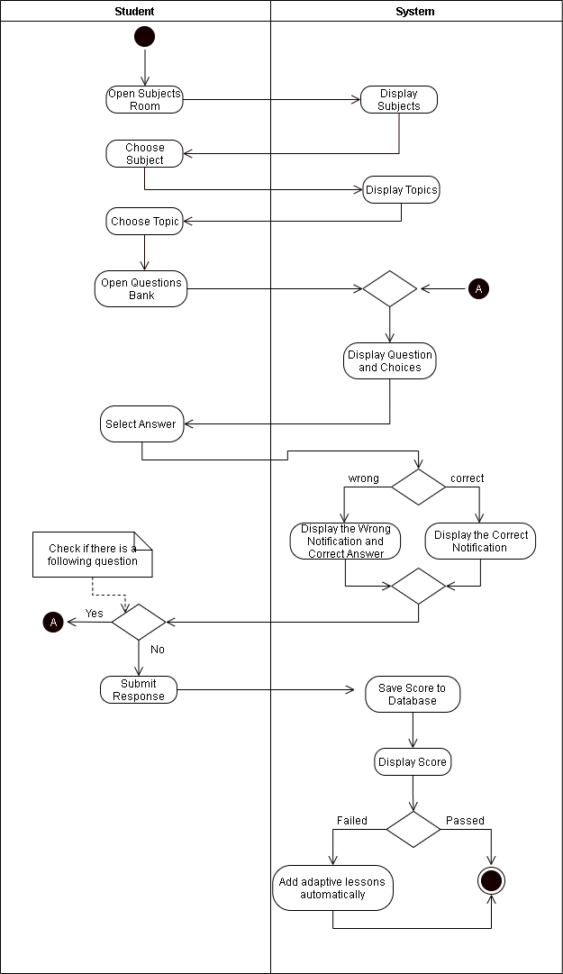
Activity Diagram for Assessment Questions
Chapter 3

Slide 34
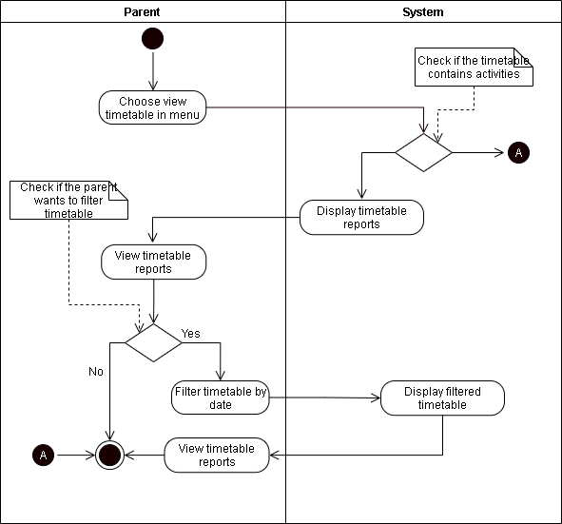
Activity Diagram for Parent’s Viewing Timetable
Chapter 3

Slide 35
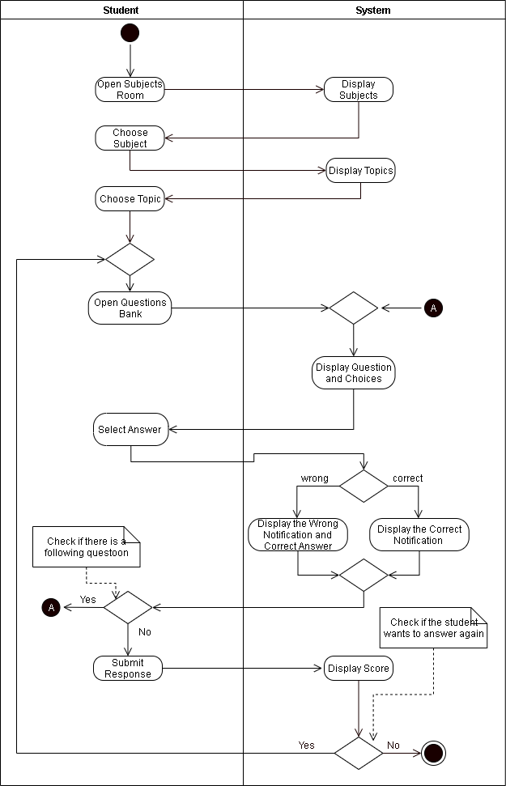
Activity Diagram for Trial Question
Chapter 3

Slide 36
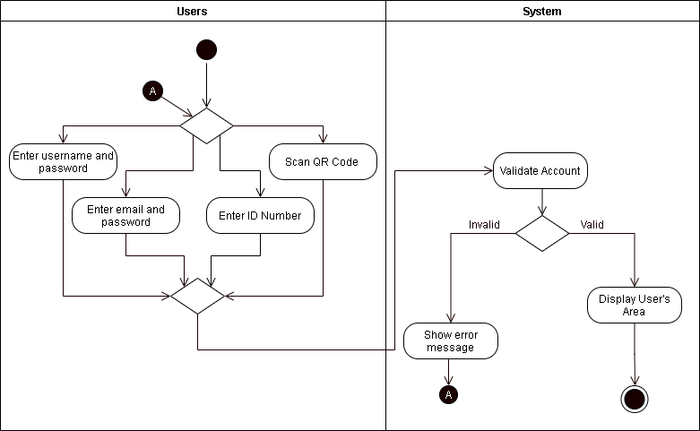
Activity Diagram for Users Login
Chapter 3

Slide 37
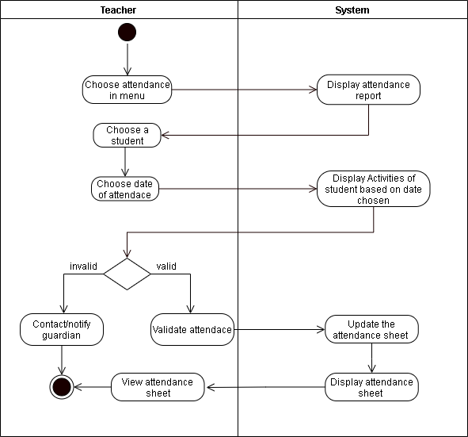
Activity Diagram for Validating of Attendance
Chapter 3

Slide 38
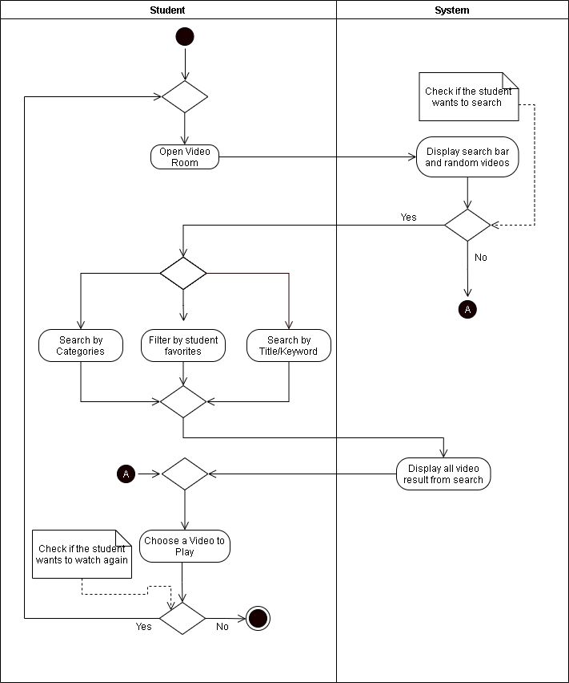
Activity Diagram for Student Playing Videos
Chapter 3

Slide 39
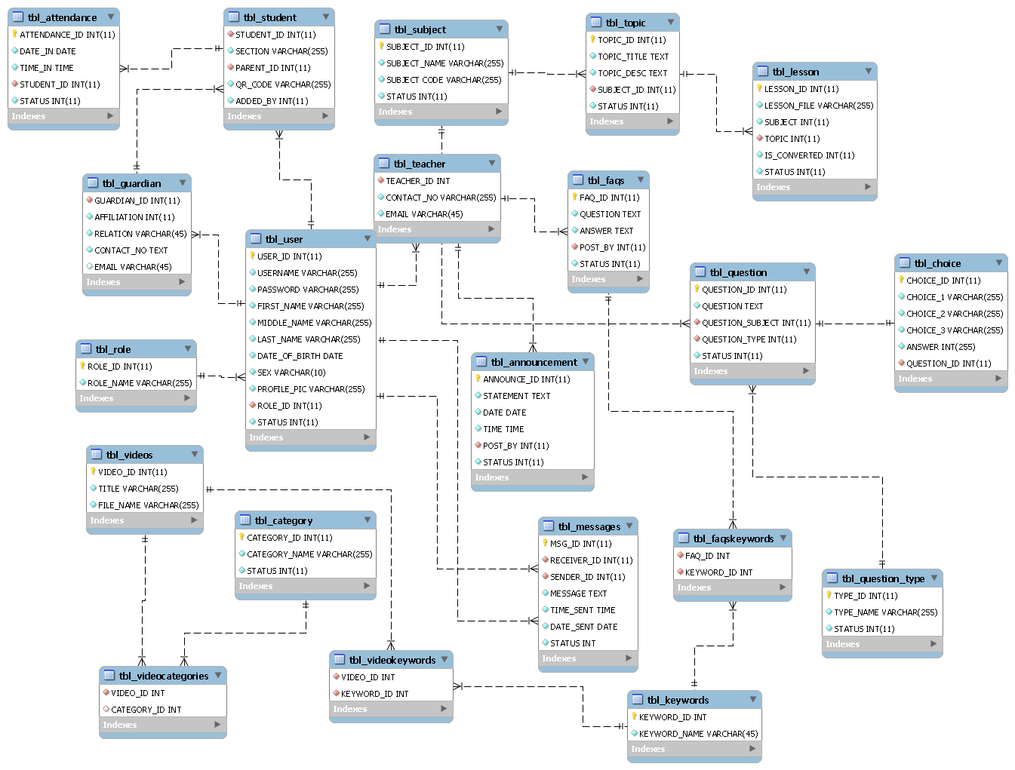
Entity-Relationship Diagram
Chapter 3

Slide 40
THANK YOU!

